Slide 1
ACA Update
2025 Ag Claims Conference
March 10-11
Doug & Julie Overdeer

Slide 2
Why Become a Part of the ACA?
Membership has benefits!
Visit agclaimsassociation.com or call us.
Train and Educate
Inform
As the industry’s premier training and education provider, we bring together subject matter experts in numerous areas to transfer knowledge and build skills. We use several cutting-edge techniques and modern methods in the courses and events we conduct. Additionally, certifying industry members is the first step to centering and improving the industry. We are also certified CE providers that help with license CE requirments.
The heart of our information-sharing pillar is our world-class website, which houses our videos, numerous tools, and resources. We also use social media, newsletters, and industry updates to inform during critical events or changes that impact the agriculture claims season or the agricultural insurance industry.
Connecting Resources to Requirements
What We Do
Annual ACA Conference
Live Training Events
Training Modules
Certifications
Industry Updates
Virtual Training Events
What We Offer
CE Credit
Claims Support – Phone
Tools
References
Videos
News
It often takes a team to solve and close a claim. The ACA has an entire group of members and sponsors who provide claim support. Network at our events or make a phone call to us, and we can connect a resource to your requirement.
Notes:
© Copyright PresentationGO.com – The free PowerPoint and Google Slides template library

Slide 3
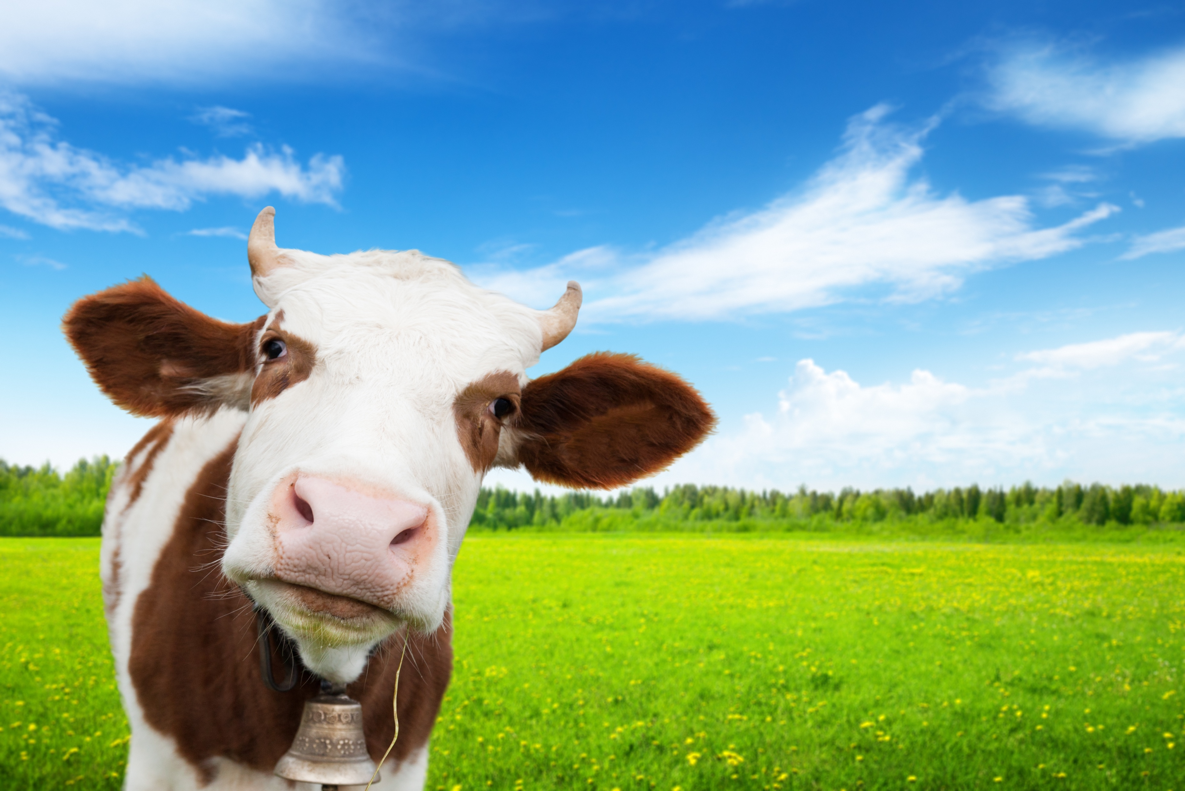
New – Cow-out Module
Online training module to teach the basics of investigating and adjusting cattle trespass claims.
Launching February 1 for beta testing, required for CE (TX & FL).
We need 25 testers.
Once CE is approved, retake the module (and for a $10 admin fee), you will receive the CE.
Visit www.agclaimsassociation.com.

Slide 4
ACA – Plan 2025
Partnership with IRMI
Launch Cow-out Module – For CE testing
In-person, 3-day Crop Liability Certification Course
Launch Ethics Module #1 with CE – Free to ACA Members
Live one-day training event – Irrigation Pivots, including ½ day of study in the field
Live one (1) day training event – Grain Bins, including ½ day of study in the field
Conference 2026
Add Drone Zone to website

Slide 5
Our Footprint
Region 1 (Midwest)
Region II (Central)
Washington
Maine
Montana
North
Dakota
Vermont
New
Hampshire
Oregon
Minnesota
New
York
Massachusetts
South
Dakota
Wisconsin
Connecticut
Rhode
Island
Idaho
Michigan
Wyoming
Pennsylvania
New
Jersey
Iowa
Nebraska
Indiana
Ohio
Maryland
Delaware
Nevada
Illinois
West
Virginia
Utah
Colorado
Virginia
California
Kansas
Missouri
Kentucky
North
Carolina
Tennessee
Oklahoma
South
Carolina
Arizona
New
Mexico
Arkansas
Mississippi
Alabama
Georgia
Texas
Louisiana
Florida
Alaska
Hawaii
Region III (South)
© FreePowerPointMaps.com
Notes:
United States of America with Individual States – Outline & State Names

Slide 6
Who is the Agriculture Claims Association
Why should I be a member?

Slide 7
Valuable Resources
As an ACA member, you access a library of Agricultural Claims Checklists and Forms to streamline your work efficiently.
Strengthen your skills with detailed Case Studies that provide practical solutions to complex issues.
Access curated Web Resources and Links to stay informed about the latest industry developments (see below for a preview).
Past Conference Content
Revisit past conferences with Presentation Videos, Training Material, and PDFs of presentations.
Continuing Education
Earn Texas and Florida Continuing Education Credits tailored to agricultural issues.
Exclusive Discounts
Benefit from Discounted Registration to conferences and reduced fees for top Training and Certifications.
Connect with Experts
Network with Industry Experts like engineers, equipment salvors, and farm/ranch specialists for mentorship and collaboration.

